Slide 1
Smart Medicine Reminder Box
Damian Xavier - SA24 610865
B.W.T.T De Silva - SA25 610161
Supervisor : Dilanka Wijesena

Slide 2
Introduction
Forgetting to take medicine on time is an issue that most people have faced at multiple times in their lives.
The Smart Medicine Reminder Box solves this issue.

Slide 3
Aim and Objectives
Aim:
To design a smart reminder system that alerts users to take their medicine at the correct time.
Objectives:
To enable the user to set alarm times using potentiometers.
To provide both visual and audio alerts at the alarm time.
To simulate and test the design in Proteus.
To display all time-related data and communicate with user through an LCD display.

Slide 4
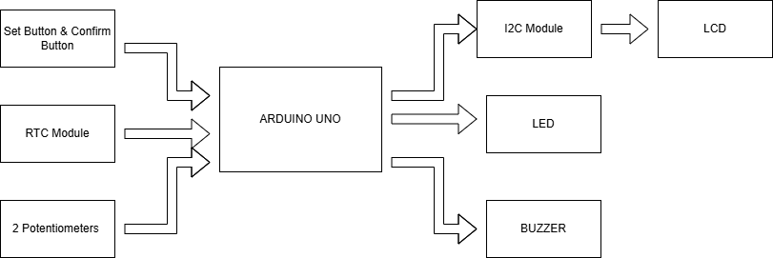
Block Diagram

Slide 5
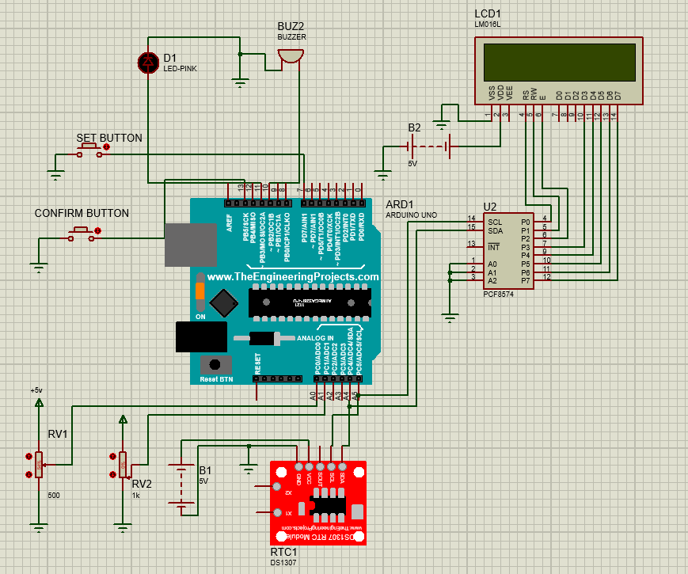
Schematic Diagram

Slide 6
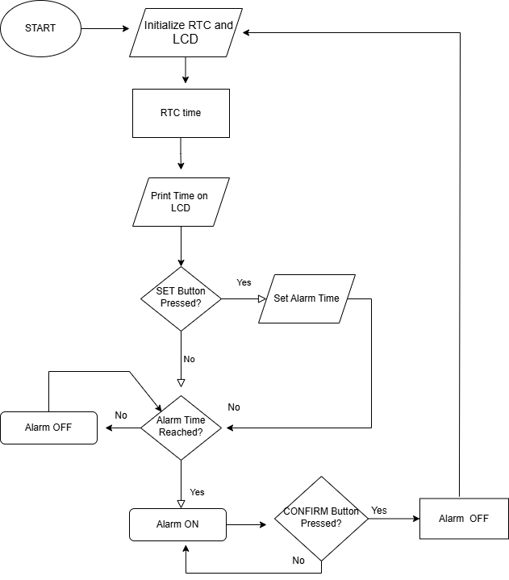
Flow Chart

Slide 7
Results
The system operating correctly during proteus simulation.
Alarm was accurately triggered at set time.
Test Condition | RTC Time | Set time | LED/Buzzer sate | User action
Before Alarm time | 11:59 | 12:00 | OFF | -
At Alarm time | 12:00 | 12:00 | ON | Take medicine Press confirm
After confirmation | 12:00 | 12:00 | OFF | Set time for new alarm time if required

Slide 8
Conclusion
The Smart Medicine Reminder successfully achieved all project objectives.
It effectively reminds users to take their medicine at precise time.

Slide 9
References
[[1]
“RTClib,” GitHub, Sep. 20, 2021. https://github.com/adafruit/RTClib
‌[2]
J.Rickman, “LiquidCrystal_I2C,” GitHub, Oct. 01, 2021. https://github.com/johnrickman/LiquidCrystal_I2C
[3]
C. Gode, M. Narlawar, M. Thakare, N. Lakade, P. Parate, and S. Kayarkar, “Smart Medicine Reminder Box,” 2024 2nd International Conference on Emerging Trends in Engineering and Medical Sciences (ICETEMS), pp. 71–74, Nov. 2024, doi: 10.1109/icetems64039.2024.10965105.
[4]
The Bright Light, “Interfacing DS1307 RTC With Arduino UNO With Code and Circuit || Proteus Simulation,” YouTube, Jan. 20, 2023. https://www.youtube.com/watch?v=cPcJNhXd-vk
[5]
Atopet Automations, “STOP the I2C Confusion! Simulate LCD with PCF8574 in Proteus (Correct Address Explained)",” YouTube, Jun. 14, 2025. https://www.youtube.com/watch?v=0u0lIQrxgHo
‌

